Slide 1


CMR TECHNICAL CAMPUS UGC AUTONOMOUS Accredited by NBA & NAAC with ‘A’ Grade Approved by AICTE, New Delhi and JNTU, Hyderabad Kandlakoya(V), Medchal Road, Hyderabad-501401, Telangana Department of Computer Science and Engineering Optimised stacked ensemble techniques in the prediction of cervical cancer using SMOTE and RFERF
BATCH NO : 08
Ch.Venkateshwarlu 217R1A0517
P.Prabhudeva 217R1A0546
A.Vishnuvardhan reddy 217R1A0504
Under the Guidance of
DR.S.SUMA
(Assistant Professor)

Slide 2
Introduction
Abstract
Existing system
Disadvantages of existing system
Proposed system
Advantages of proposed system
Hardware and software requirements
Novelty
Architecture
Modules
UML Diagrams
Sample Code
Results
Conclusion
Future Scope
References
Github Link
CONTENTS

Slide 3

INTRODUCTION
Cervical cancer is one of the most common cancers affecting women worldwide, especially those between the ages of 35 and 44.
This disease often goes undetected in its early stages due to a lack of noticeable symptoms,like weight loss,swelling in the legs making early diagnosis crucial for improving survival rates.
Risk factors such as HPV infection, smoking, and hormonal contraceptives increase the likelihood of developing cervical cancer.

Slide 4
ABSTRACT
Machine learning-based approach for cervical cancer prediction by utilizing ensemble techniques and feature selection method. The methodology integrates advanced algorithms such as Decision Tree,Random Forest and KNN along with Logistic Regression as an ensemble techniques to analyze a clinical dataset containing cervical cancer risk factors. The Synthetic Minority Oversampling Technique (SMOTE) is applied to address data imbalance, while Recursive Feature Elimination (RFE) optimizes the selection of important features. This hybrid approach enhances the accuracy and robustness of the predictions. Experimental results demonstrate that the proposed model significantly improves cervical cancer diagnosis, with better accuracy.

Slide 5
EXISTING SYSTEM
The dataset used includes cervical cancer risk factors from the UCI repository, with 32 features and 4 diagnostic test targets (Hinselmann, Schiller, Cytology, Biopsy).
To handle the imbalance in the dataset, the Synthetic Minority Oversampling Technique (SMOTE) is used, balancing the data effectively.
Firefly optimization algorithm are used to reduce features and select the most relevant ones for improving prediction accuracy.
Three ensemble methods, Extreme Gradient Boosting (XGBoost), AdaBoost, and Random Forest, are employed to enhance model performance. XGBoost proved to be the most effective.

Slide 6
DisadvantageS of Existing System
Class Imbalance
Missing data
Feature Relevance

Slide 7
Proposed system
The proposed system leverages machine learning techniques to enhance the prediction of cervical cancer by integrating various methods for data processing and classification.
The system begins by using SMOTE (Synthetic Minority Over-sampling Technique) to address class imbalances within the dataset, ensuring the model is trained on balanced data and preprocessing the dataset to deal with missing values.
RFE (Recursive Feature Elimination) with Random Forest is applied to select the most significant features, improving the model’s performance.
The core of the system is a Stacked Ensemble Technique, which combines multiple classifiers, including Random Forest, Decision Tree, and K-Nearest Neighbors (KNN), with Logistic Regression as the final estimator.
This ensemble approach helps capture complex patterns in the dataset, leading to more accurate predictions.By integrating these techniques, the system enhances the precision, recall, and overall accuracy of cervical cancer prediction

Slide 8
Advantages of proposed system
Increased Accuracy
Real-time Prediction Capability
Visualization of Results
Scalability

Slide 9

Requirements specification
Hardware requirements :
System : Windows
Processor : Intel Core i3 or higher
Hard disk : 512GB
RAM : Atleast 4GB
Software requirements :
Operating System : Windows 10 or 11
Coding Language : Python 3.7.0
Libraries : Pandas,Matplotlib,Seaborn
Visualization Tools : Matplotlib,Seaborn

Slide 10
NOVELTY
Unlike the existing methods that use individual classifiers, the proposed system combines multiple classifiers (Random Forest, Decision Tree, K-Nearest Neighbors) into a stacked ensemble.
Logistic Regression is used as the final estimator, enhancing prediction accuracy by integrating the strengths of multiple models.
SMOTE for data balancing and RFE for feature selection are combined with a stacked ensemble, optimizing the model from data preprocessing to prediction.
The integration of multiple classifiers helps in capturing complex data patterns, leading to better precision, recall, and accuracy in cervical cancer prediction.
The adaptability of the stacked ensemble method combined with RFE makes this approach more resilient and effective than conventional models, offering a robust solution for early cervical cancer detection.

Slide 11
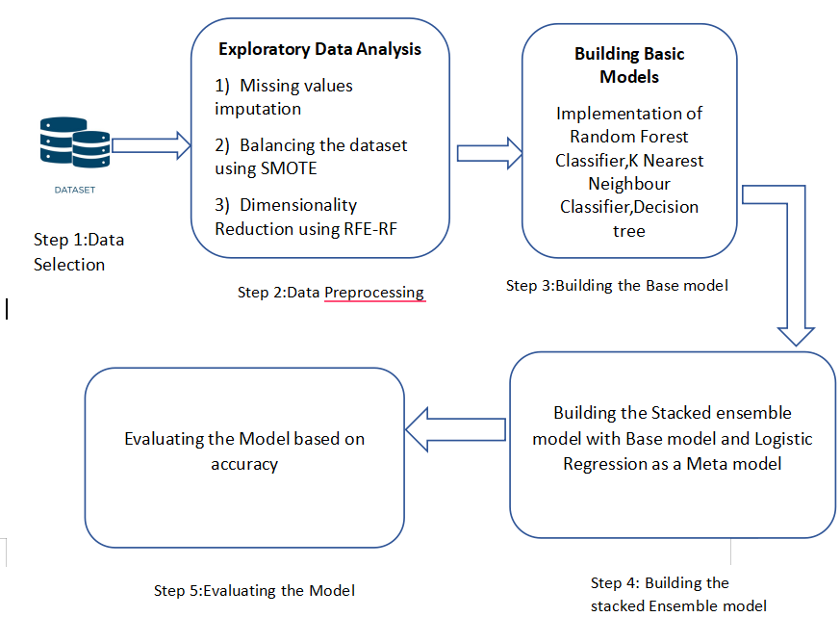
ARCHITECTURE

Slide 12
MODULES
Data Collection and Preprocessing
Data Balancing
Feature Selection
Model Building
Model Evaluation

Slide 13
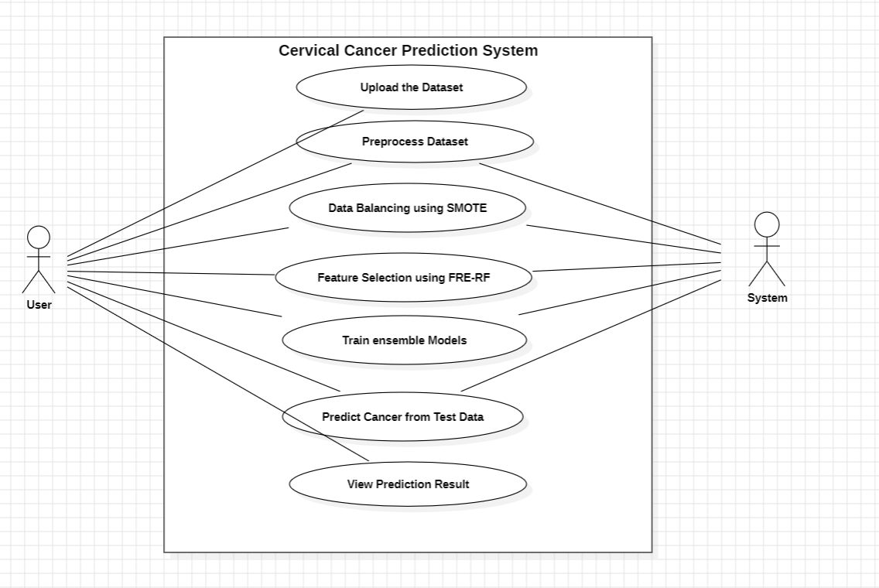
UML DIAGRAMS
USE CASE DIAGRAM:

Slide 14
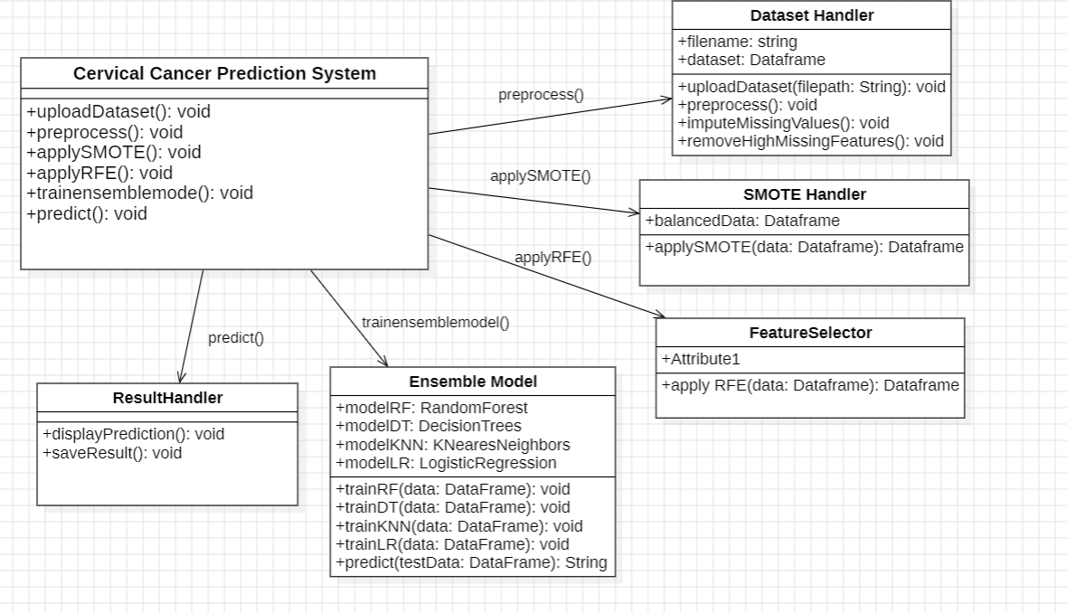
UML DIAGRAMS
CLASS DIAGRAM

Slide 15
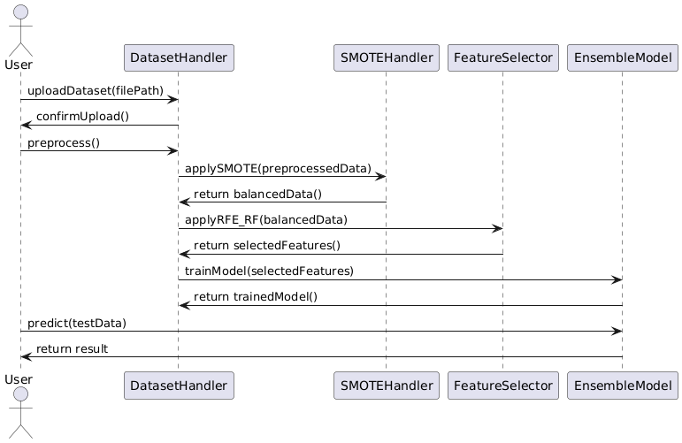
UML DIAGRAMS
SEQUENCE DIAGRAM

Slide 16
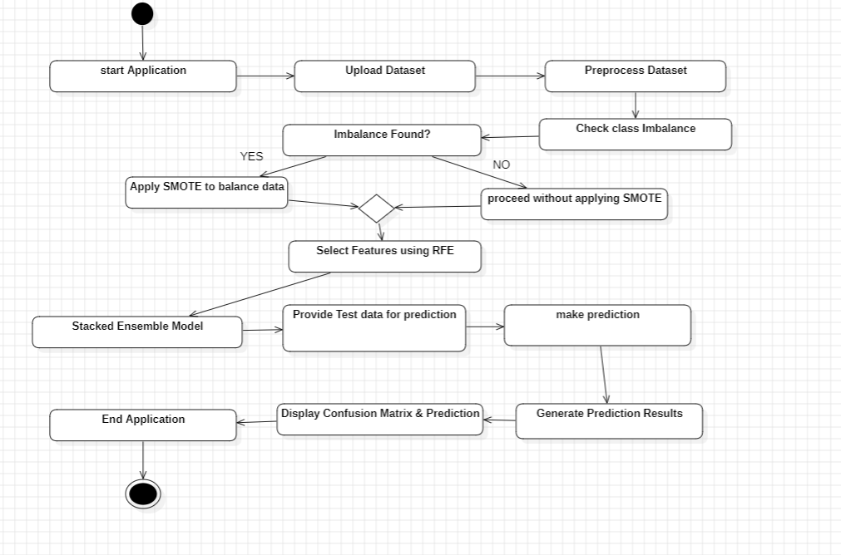
UML DIAGRAMS
ACTIVITY DIAGRAM

Slide 17
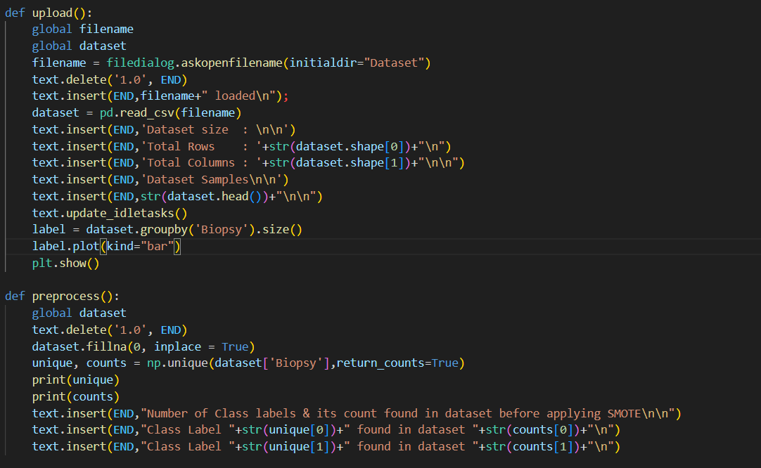
SAMPLE CODE

Slide 18
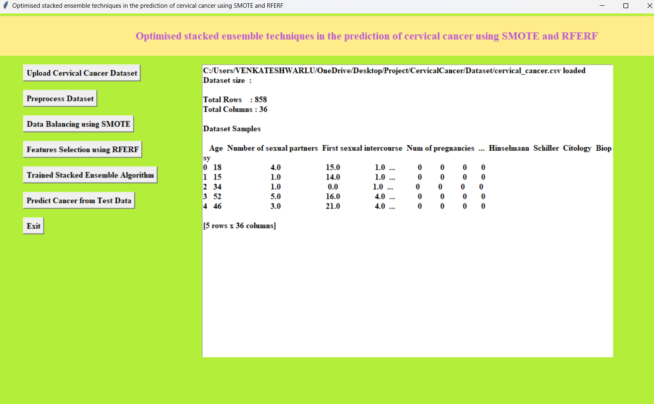
RESULTS

Slide 19
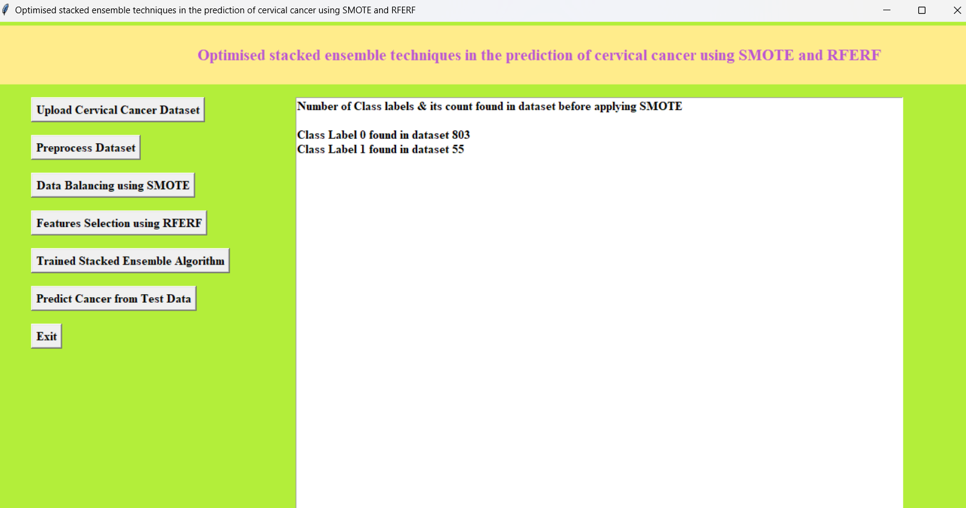
RESULTS

Slide 20
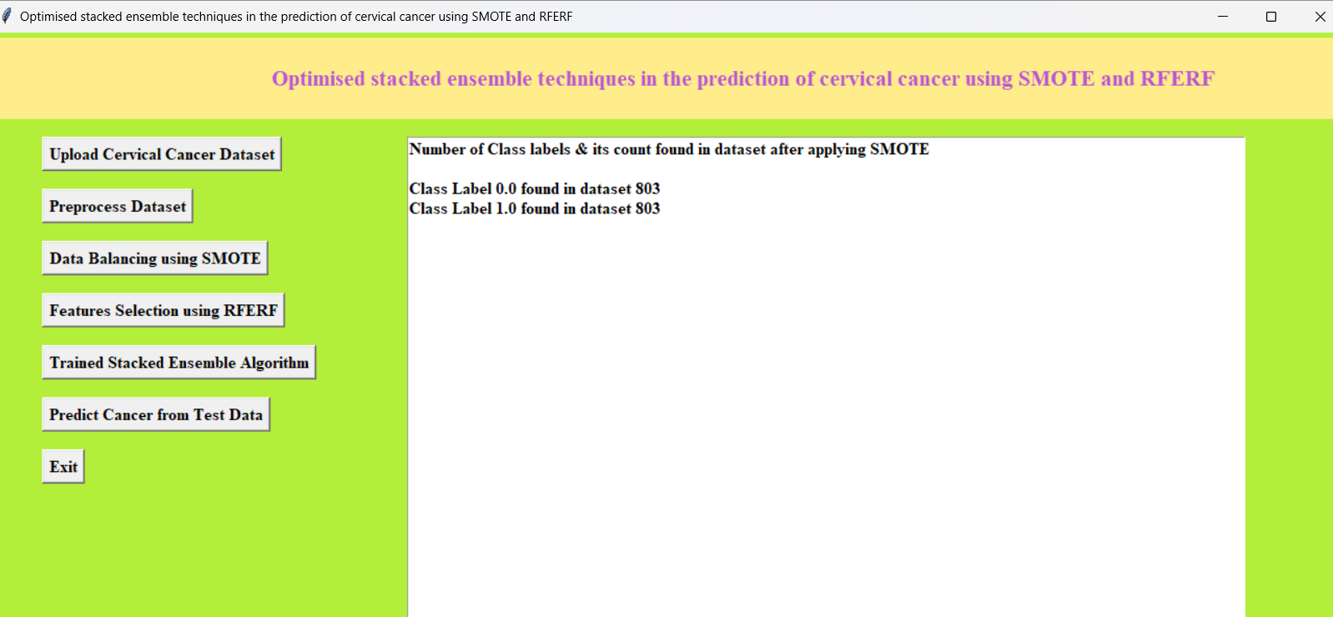
RESULTS

Slide 21
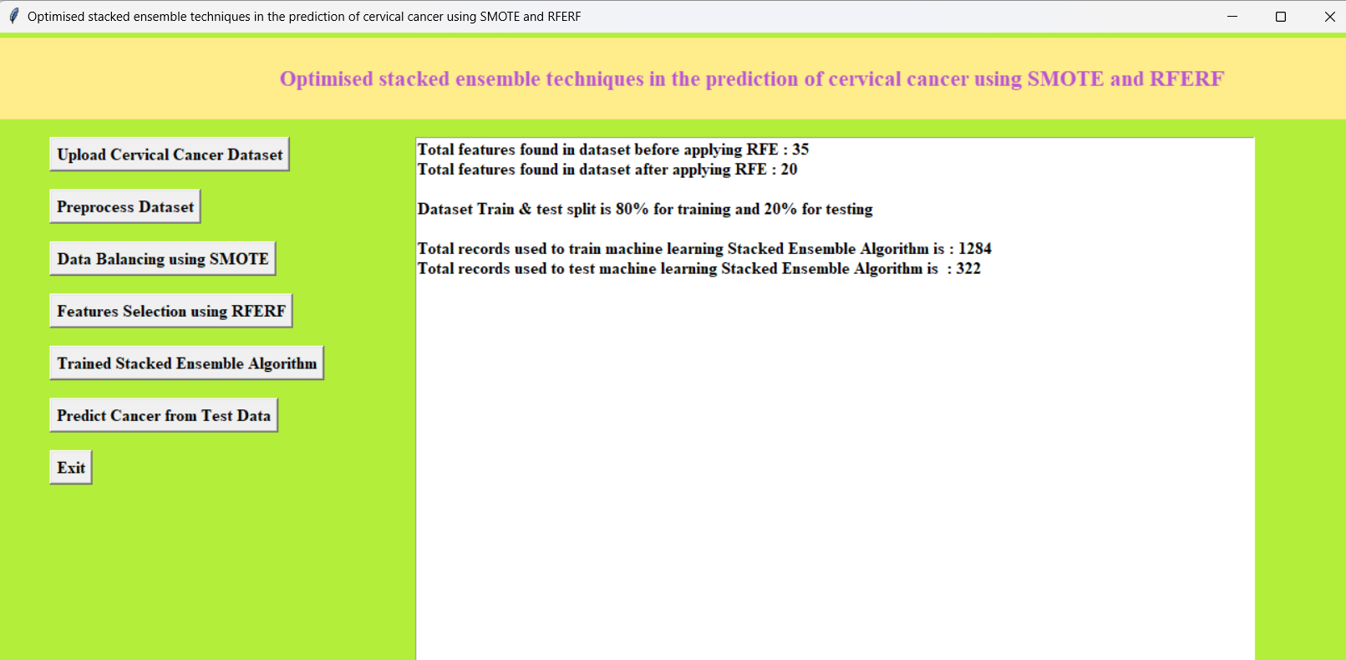
RESULTS

Slide 22
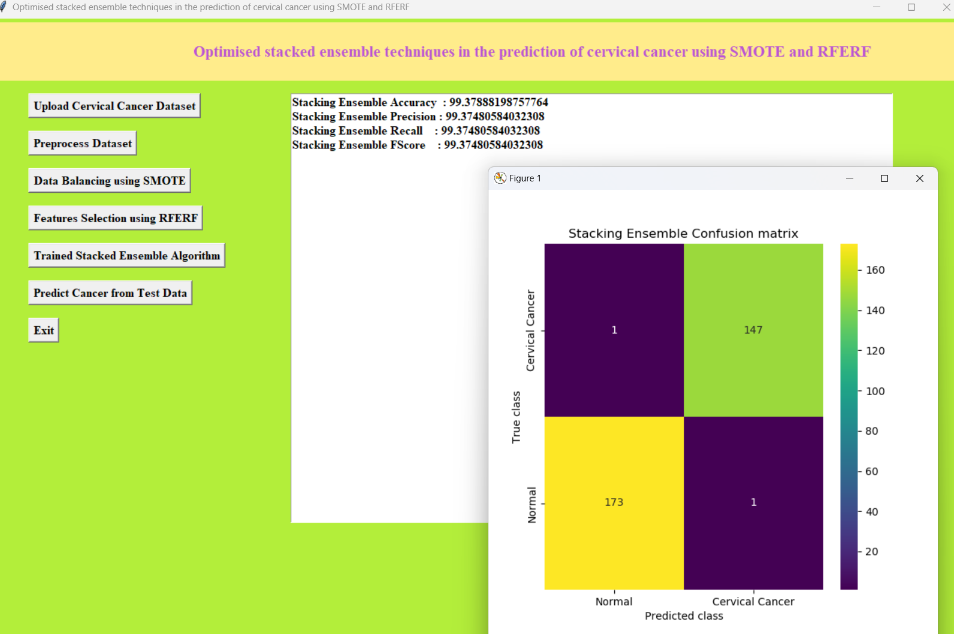
RESULTS

Slide 23
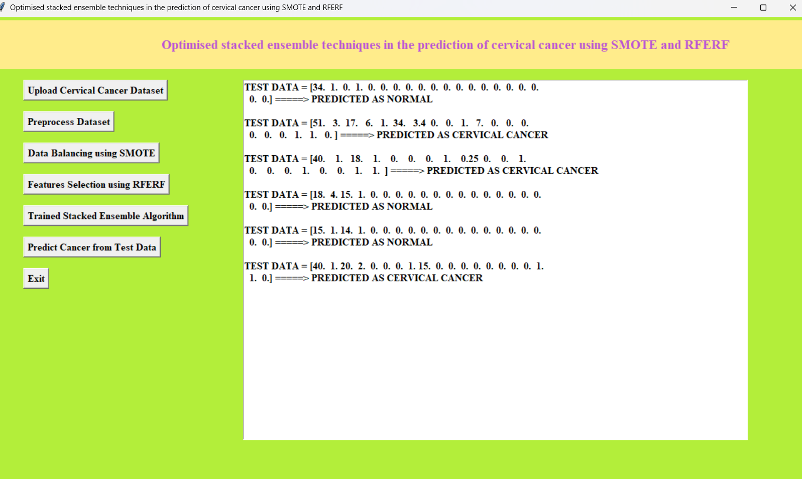
RESULTS

Slide 24
COnclusion
ML-based approach for cervical cancer prediction, utilizing a stacked ensemble model along with SMOTE for data balancing and RFE for feature selection, proves to be highly effective. The methodology integrates multiple classifiers, including Random Forest, Decision Tree, and K-Nearest Neighbors, into an optimized ensemble model, improving the accuracy of cancer detection. Experimental results demonstrate significant performance improvements, with the ensemble model achieving higher accuracy, precision, recall, and F1-score compared to individual classifiers. The computational efficiency of the approach is enhanced through feature selection, reducing model complexity while maintaining high predictive accuracy. Additionally, the inclusion of SMOTE ensures balanced class distribution, which is crucial for accurate predictions in imbalanced datasets like those in medical diagnosis.

Slide 25
FUTURE SCOPE
Develop intuitive, clinician-friendly interfaces that enable easy integration into clinical workflows and decision-making.
Future developments may also include leveraging advanced machine learning algorithms, such as deep learning, to better detect complex patterns in the data.
Extend the model validation by testing on larger and more diverse datasets to ensure scalability and robustness across different populations.
Explore deep learning models and techniques such as CNNs and RNNs for further improvement in prediction accuracy and feature extraction.
Real-time monitoring and personalized cancer predictions could offer healthcare professionals tailored insights for early intervention

Slide 26
REFERENCES
American Cancer Society, Key Statistics for Cervical Cancer, American Cancer Society, Atlanta, GA, USA, 2021, https:// www.cancer.org/cancer/cervical-cancer/about/key-statistics. html.
“Cervical cancer: risk factors,” 2020, https://www.cancer.net/ cancer-types/cervical-cancer/risk-factors#:%7E:text=+e% 20most%20important%20risk%20factor,100%20different% 20types%20of%20HPV.
“Cervical cancer,” 2020, https://www.nccc-online.org/ hpvcervical-cancer/cervical-cancer-overview/.

Slide 27
Github Link
https://github.com/Venkateshm8/Prediction-of-Cervical-Cancer/blob/main/Main.py

Slide 28


